Slide 1

Predictive QC Lion King Results - PC stage model

Slide 2
Table of contents
Approach
Results – Summary
Results – Deep dive

Slide 3
Approach
Determine efficiency of data science algorithms to predict error occurrence for each section and error scale in QC Checklist
Conditions:
Stage -> PC
We analyzed only first iteration of checklist (no re-works)
Some categories in QC Checklist were combined into new categories due to low error ratios which would make building model very difficult (if not impossible)
What data sources we used:
QC Checklists
Holiday Tracker
Workflow data
Details about dataset:
1941 checklists completed
time range: 30-12-2019 - 10-06-2020
Features added in this iteration:
analyst performance on DR/CO stages (number of cases processed and errors made)
features related to MLRO request and cases from the same capital group
changed approach of calculating analysts performance from last X number of days to last X number of checklists

Slide 4
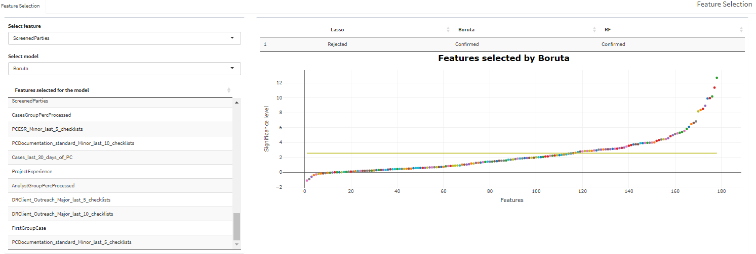
Data Preparation
We combined all three data sources into single table using Python. We dropped features with high number of empty observation and dropped cases for which we didn’t have majority of data points. In total we were working on 1871 cases
Then we run feature selection on top of it in order to investigate what attributes have most impact on error occurrence. This task was repeated for each section included in QC Checklist (9 sections) and 3 error scales (critical/major/minor). In total whole process was repeated 12 times.
Feature selection:

Slide 5
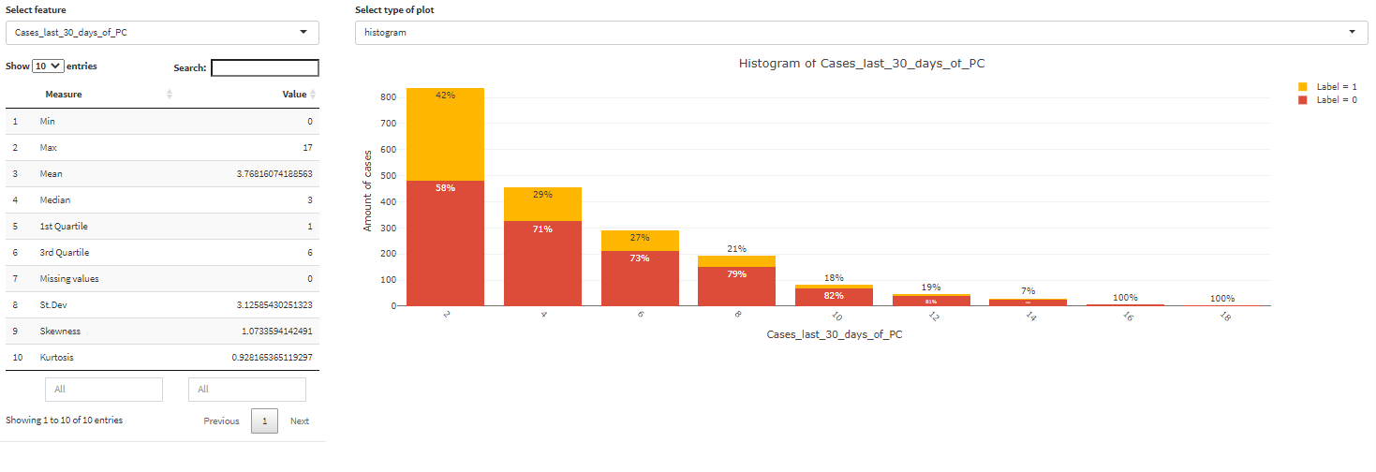
Data Preparation
Data analysis:

Slide 6
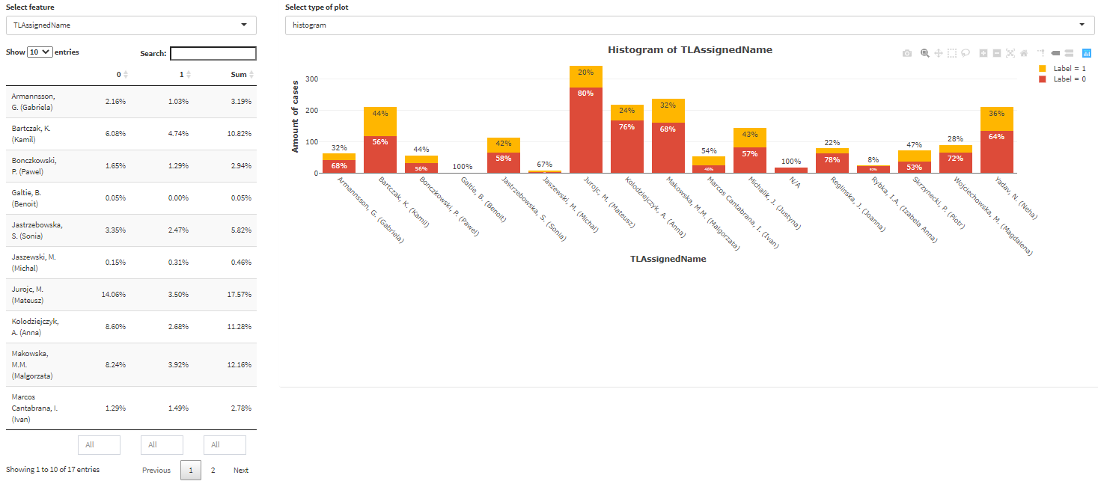
Data Preparation
Data analysis:

Slide 7
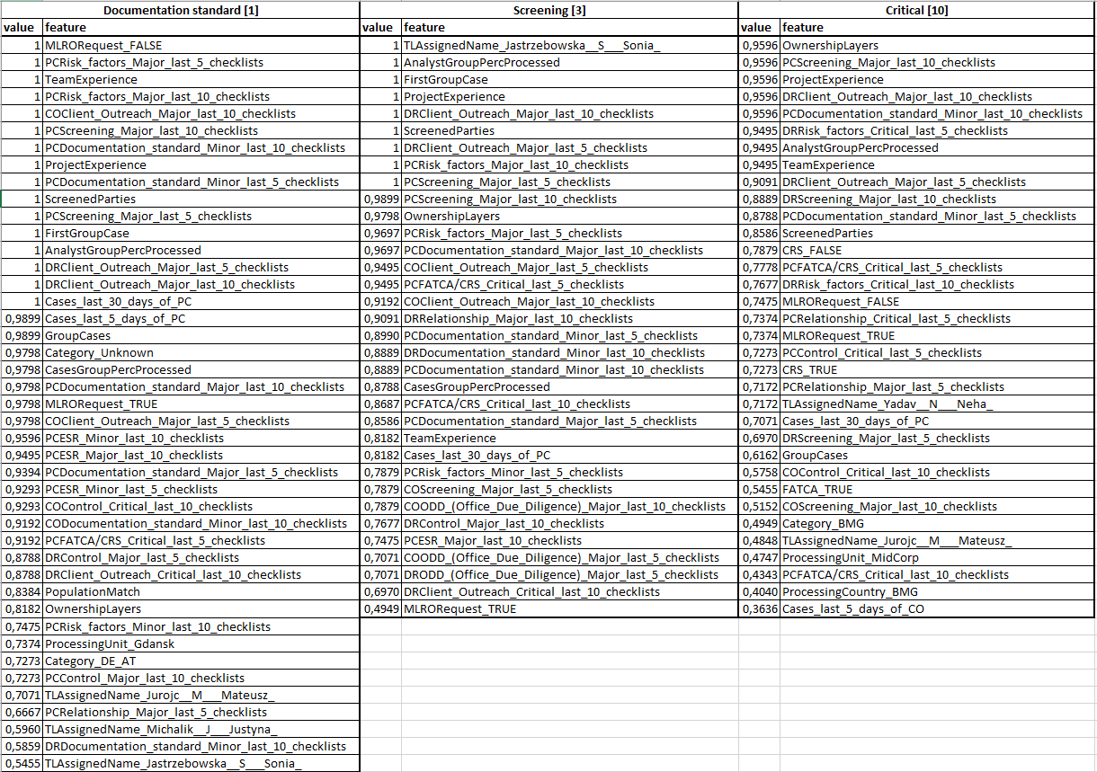
Data Preparation
Example of feature selection used for modelling category 1, 3, and 10. Features are sorted from most to least important.
Dictionary:
Feature Name | Description
MLRORequest_FALSE | Analyst did not place request to MLRO
TLAssignedName | Team leader of analyst’s assigned to the case
OwnershipLayers | Number of layers in ownership structure of the screened entity
PCRisk_factors_Major_last_5_checklists | Number of major errors made by analysts in Risk factors section in last 5 checklists before case submission to QC
AnalystGroupCasePercProcessed | Percentage of cases from the same group processed by the analyst
FirstGroupCase | Binary flag that indicates whether the case was the first one from the group processed by analyst
ProjectExperience | Number of days since date analyst join the project
GroupCases | Number of cases from the same group
Cases_last_30_days_of_PC | Number of cases processed by the analyst during last 30 days (PC stage)
ScreenedParties | Number of screened entities during analysis
CRS_FALSE | CRS marked as false

Slide 8
Modelling
After completing feature selection we split our dataset in two categories. We trained our models using around 80% data volume and then tested it on remaining 20%. We want to see how good model is predicting errors on data it hasn’t seen before.
Train data 80%
Test data (20%)
Data was stratified on case submission date and error ratio to ensure even distribution in time on both datasets.
Models:
We tried four different algorithms in modelling phase:
Classification Random Forest
Gradient Boosted Machine
Neural Networks (best results)
Penalized Logistic Regression (Lasso) - stable results due to algorithm simplicity
We chose neural networks, because Area Under the Curve (AUC) parameter was highest. Moreover, performance of the model for train and test data was most similar. AUC is a metric used for model evaluation which is an indicator how well model can distinguish positive and negative observations (the higher AUC the better)

Slide 9
Results - Summary
No. | Category Name | No questions | Train Sample Size | Test Sample Size | Errors [%] | Errors amount | AUC Train | AUC Test | Train 75% | Test 75%
1 | Documentation standard | 15 | 1468 | 337 | 33,33% | 605 | 0,75 | 0,75 | 92,74 | 92,66
2 | Risk factors | 16 | 1452 | 363 | 5,51% | 100 | 0,82 | 0,82 | 97,47 | 100,00
3 | Screening | 8 | 1479 | 336 | 20,94% | 380 | 0,77 | 0,77 | 93,99 | 93,75
4 | ESR | 3 | 1452 | 363 | 3,09% | 56 | 0,95 | 0,95 | 100,00 | 100,00
5 | Client Outreach | 12 | 1452 | 363 | 1,21% | 22 | 0,79 | 0,80 | 93,75 | 100,00
6 | Relationship | 17 | 1452 | 363 | 6,94% | 126 | 0,77 | 0,76 | 95,96 | 96,30
7 | Office Due Dilligence | 2 | 1452 | 363 | 3,36% | 61 | 0,80 | 0,80 | 93,75 | 100,00
8 | FATCA/CRS | 6 | 1452 | 363 | 3,20% | 58 | 0,91 | 0,91 | 100,00 | 100,00
9 | Control | 22 | 1452 | 363 | 6,56% | 119 | 0,76 | 0,75 | 93,62 | 96,00
10 | Critical |  | 1452 | 363 | 6,06% | 110 | 0,78 | 0,78 | 97,70 | 95,65
11 | Major |  | 1480 | 335 | 36,20% | 657 | 0,79 | 0,78 | 92,78 | 93,16
12 | Minor |  | 1476 | 339 | 31,18% | 566 | 0,73 | 0,73 | 92,67 | 91,18

Slide 10
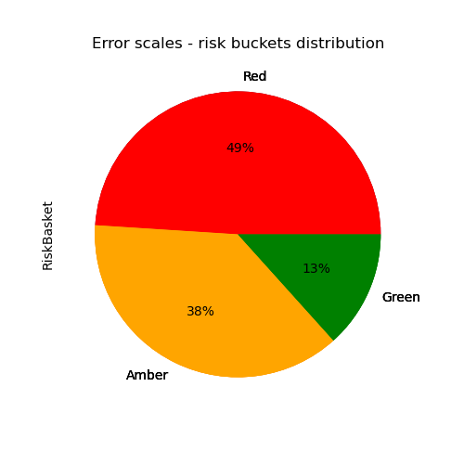
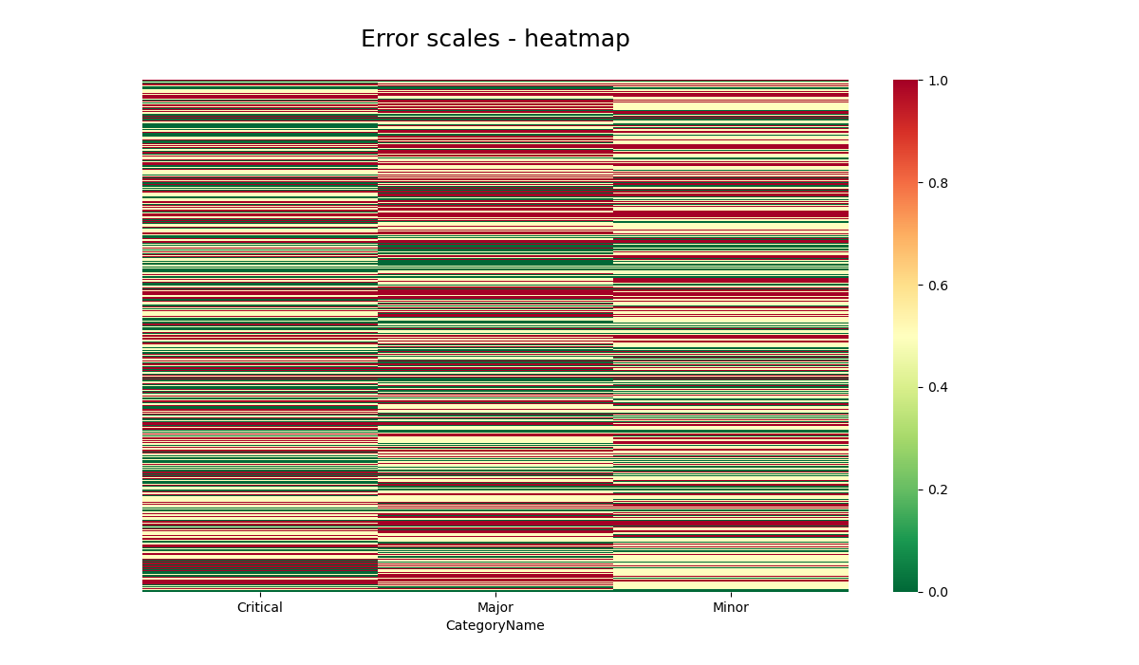
Results - Summary

Slide 11
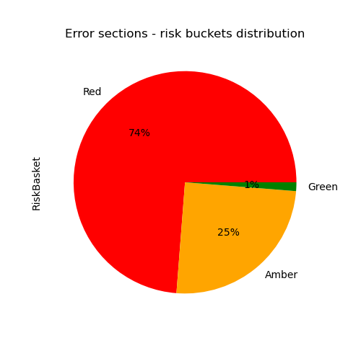
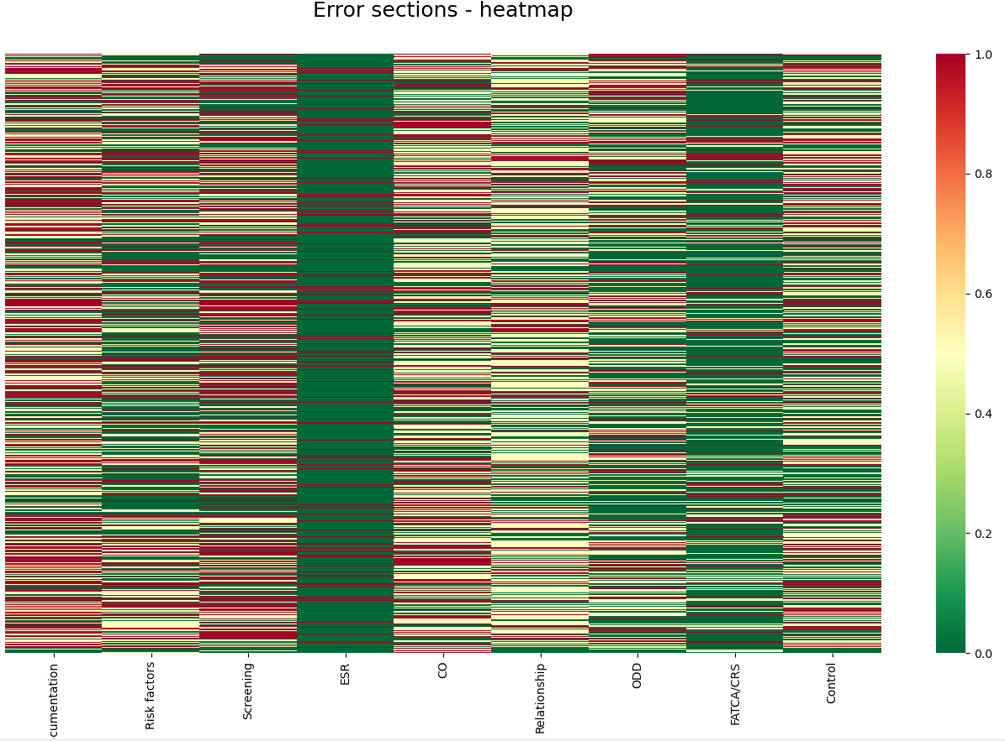
Results - Summary

Slide 12
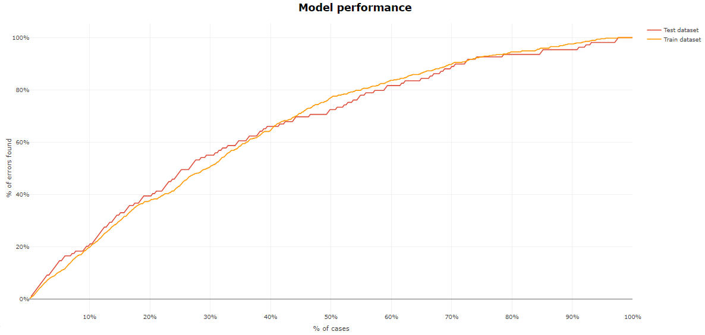
Documentation standard[1]
Full sample | Questions | Errors no | Errors ratio | Train sample | Test sample | Train sample error ratio | Test sample error ratio | 75% population cut off train | 75% population cut off test
1815 | 15 | 605 | 33,33% | 1478 | 337 | 33,56% | 32,34% | 92,74% | 92,66%
Selected population: 35% (118)
Errors detected: 61% (67)
Selected population: 39% (131)
Errors detected: 33% (36)
Selected population: 26% (88)
Errors detected: 7%(6)
Suggested cut off: 35%
Suggested cut off: 74%

Slide 13
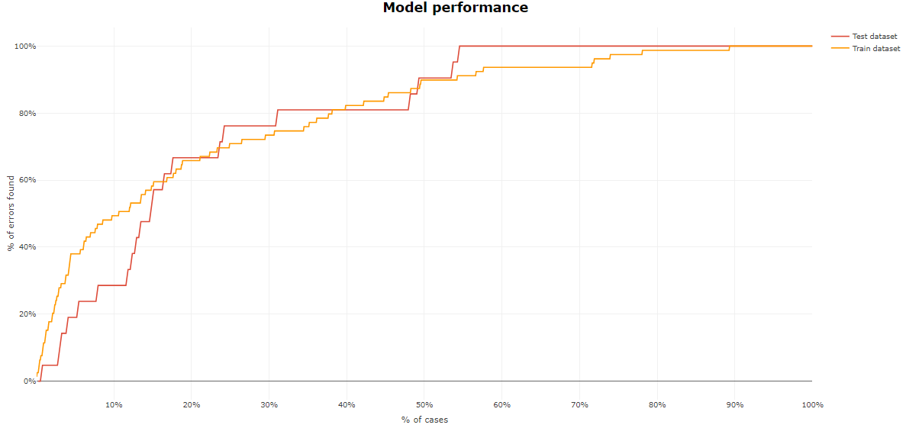
Risk factors[2]
Full sample | Questions | Errors no | Errors ratio | Train sample | Test sample | Train sample error ratio | Test sample error ratio | 75% population cut off train | 75% population cut off test
1815 | 16 | 100 | 5,51% | 1452 | 363 | 5,51% | 5,44% | 97,47% | 100%
Selected population: 24% (87)
Errors detected: 76% (16)
Selected population: 31% (113)
Errors detected: 24% (5)
Selected population: 45% (164)
Errors detected: 0%(0)
Suggested cut off: 24%
Suggested cut off: 55%

Slide 14
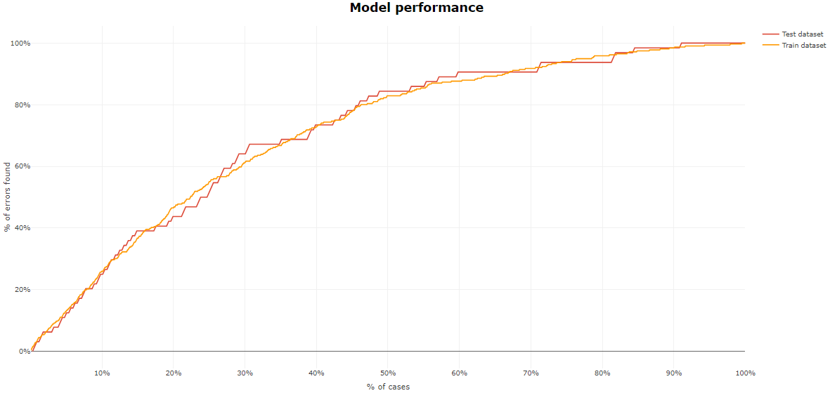
Screening [3]
Full sample | Questions | Errors no | Errors ratio | Train sample | Test sample | Train sample error ratio | Test sample error ratio | 75% population cut off train | 75% population cut off test
1815 | 8 | 380 | 20,940% | 1479 | 336 | 21,37% | 19,05% | 93,99% | 93,75%
Selected population: 31% (104)
Errors detected: 67% (43)
Selected population: 29% (98)
Errors detected: 24% (15)
Selected population: 40% (134)
Errors detected: 9%(6)
Suggested cut off: 31%
Suggested cut off: 60%

Slide 15
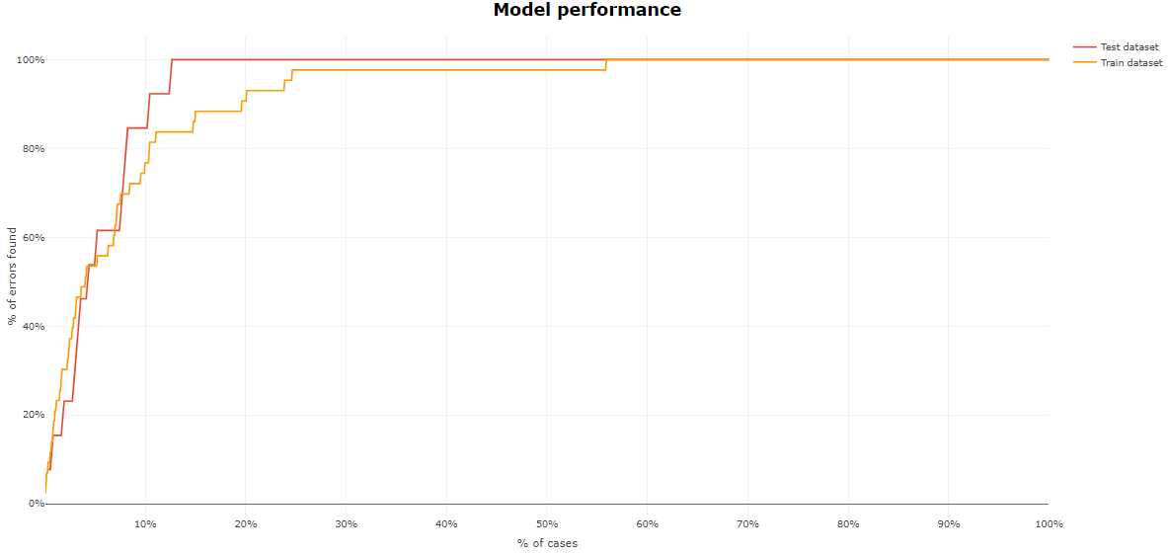
ESR[4] - Neural Network
Full sample | Questions | Errors no | Errors ratio | Train sample | Test sample | Train sample error ratio | Test sample error ratio | 75% population cut off train | 75% population cut off test
1815 | 3 | 56 | 3,09% | 1496 | 376 | 2,96% | 3,58% | 100% | 100%
Selected population: 13% (47)
Errors detected: 100% (13)
Selected population: 87% (316)
Errors detected: 0%(0)
Suggested cut off: 13%

Slide 16
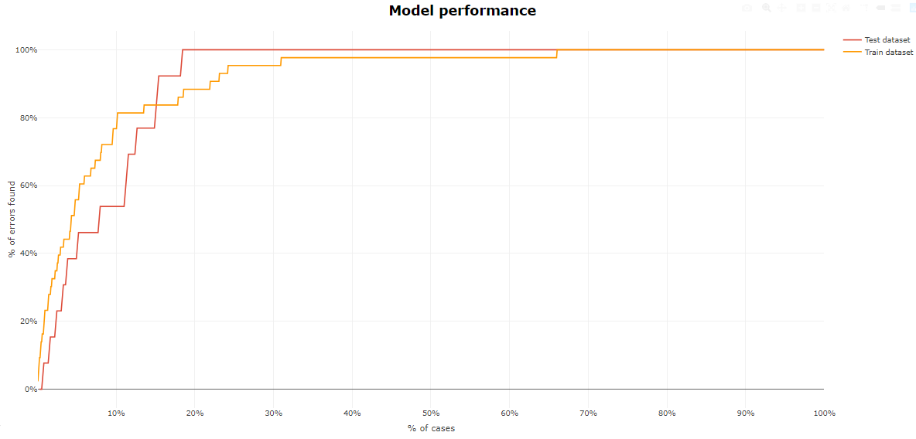
ESR[4] - Lasso Logistic Regression
Full sample | Questions | Errors no | Errors ratio | Train sample | Test sample | Train sample error ratio | Test sample error ratio | 75% population cut off train | 75% population cut off test
1815 | 3 | 56 | 3,09% | 1496 | 376 | 2,96% | 3,58% | 100% | 100%
Selected population: 19% 69)
Errors detected: 100% (13)
Selected population: 87% (294)
Errors detected: 0%(0)

Slide 17
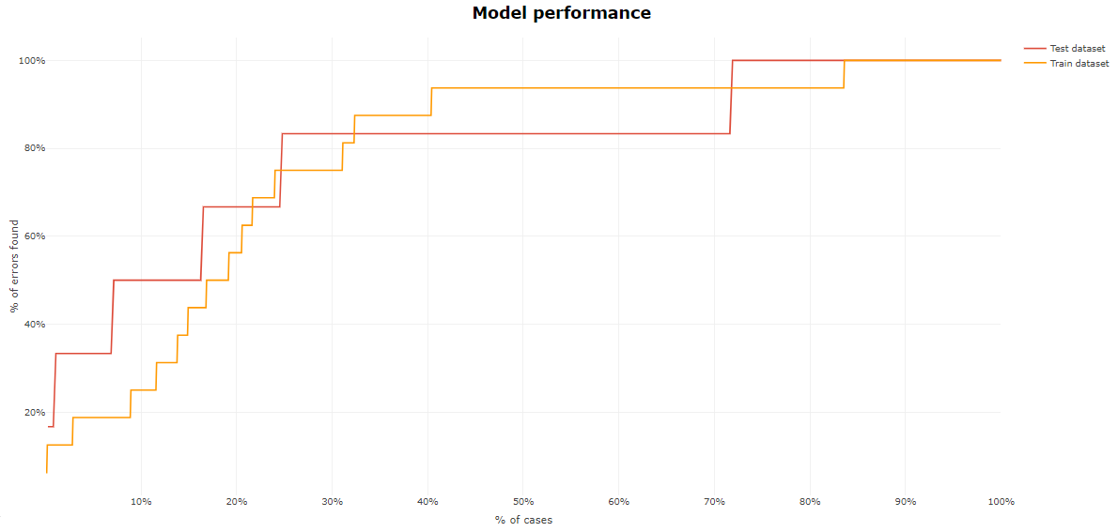
Client Outreach[5] - Neural Network
Full sample | Questions | Errors no | Errors ratio | Train sample | Test sample | Train sample error ratio | Test sample error ratio | 75% population cut off train | 75% population cut off test
1815 | 12 | 22 | 1,21% | 1452 | 363 | 1,10% | 1,65% | 93,75% | 100%
Selected population: 25% (91)
Errors detected: 83% (5)
Selected population: 47% (170)
Errors detected: 17% (1)
Selected population: 28% (102)
Errors detected: 0%(0)
Suggested cut off: 25%
Suggested cut off: 72%

Slide 18
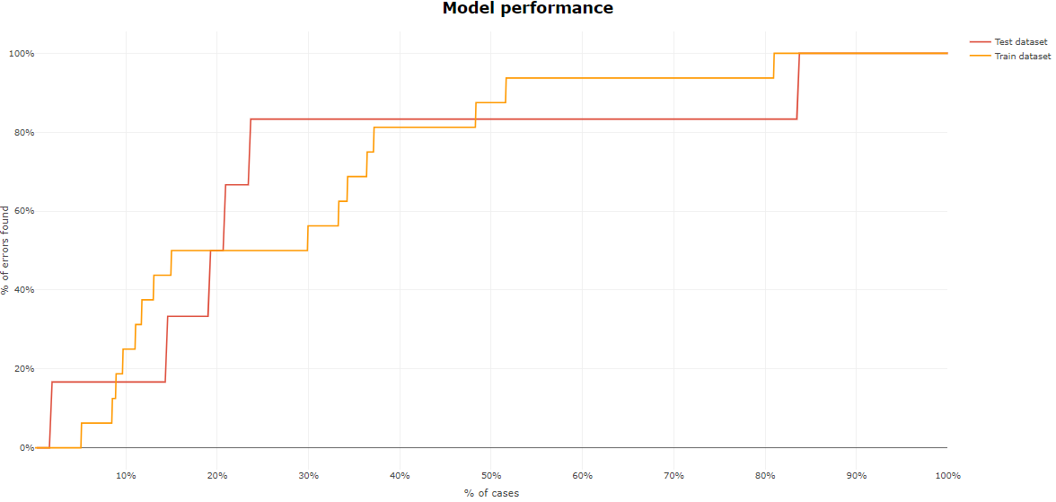
Client Outreach[5] - Lasso Logistic Regression
Full sample | Questions | Errors no | Errors ratio | Train sample | Test sample | Train sample error ratio | Test sample error ratio | 75% population cut off train | 75% population cut off test
1815 | 12 | 22 | 1,21% | 1452 | 363 | 1,10% | 1,65% | 93,75% | 100%
Selected population: 24% (87)
Errors detected: 83% (5)
Selected population: 60% (218)
Errors detected: 17% (1)
Selected population: 16% (58)
Errors detected: 0%(0)
Suggested cut off: 24%
Suggested cut off: 84%

Slide 19
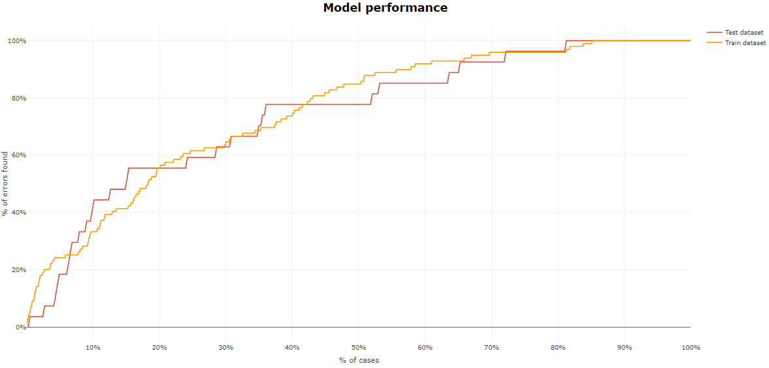
Relationship[6]
Full sample | Questions | Errors no | Errors ratio | Train sample | Test sample | Train sample error ratio | Test sample error ratio | 75% population cut off train | 75% population cut off test
1815 | 17 | 126 | 6,94% | 1452 | 363 | 6,82% | 7,44% | 95,96% | 96,30%
Selected population: 15% (54)
Errors detected: 56% (15)
Selected population: 50% (182)
Errors detected: 37% (7)
Selected population: 35% (127)
Errors detected: 7%(5)
Suggested cut off: 15%
Suggested cut off: 65%

Slide 20
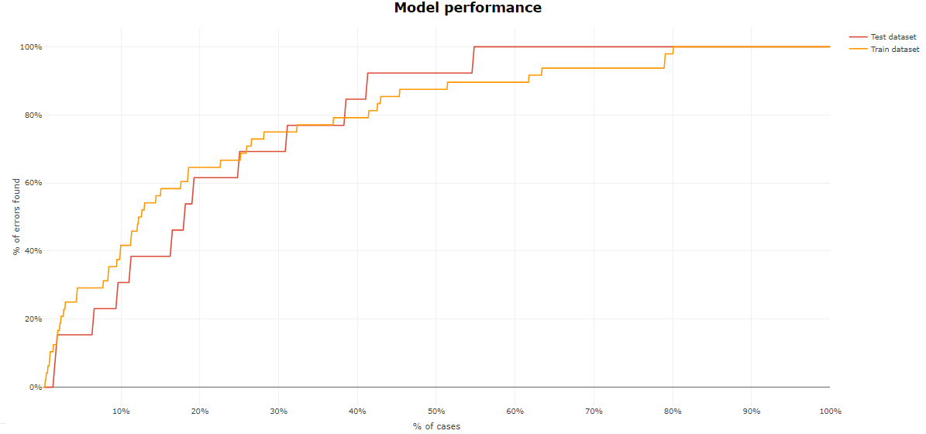
ODD (Office Due Diligence)[7] - Neural network
Full sample | Questions | Errors no | Errors ratio | Train sample | Test sample | Train sample error ratio | Test sample error ratio | 75% population cut off train | 75% population cut off test
1815 | 2 | 61 | 3,36% | 1452 | 363 | 3,31% | 3,58% | 93,75% | 100%
Selected population: 19% (69)
Errors detected: 62% (8)
Selected population: 36% (131)
Errors detected: 38% (5)
Selected population: 45% (163)
Errors detected: 0%(0)
Suggested cut off: 19%
Suggested cut off: 55%

Slide 21
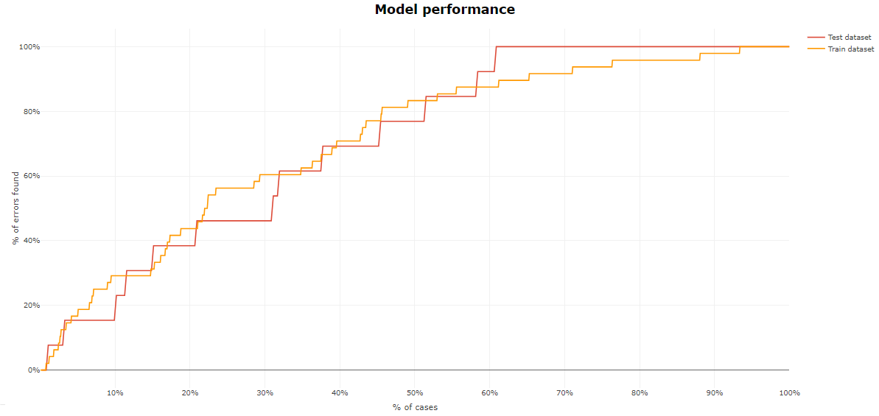
ODD (Office Due Diligence)[7] - Lasso Logistic Regression
Full sample | Questions | Errors no | Errors ratio | Train sample | Test sample | Train sample error ratio | Test sample error ratio | 75% population cut off train | 75% population cut off test
1815 | 2 | 61 | 3,36% | 1452 | 363 | 3,31% | 3,58% | 93,75% | 100%
Selected population: 21% (76)
Errors detected: 46% (6)
Selected population: 40% (145)
Errors detected: 25% (7)
Selected population: 39% (142)
Errors detected: 0%(0)
Suggested cut off: 21%
Suggested cut off: 61%

Slide 22
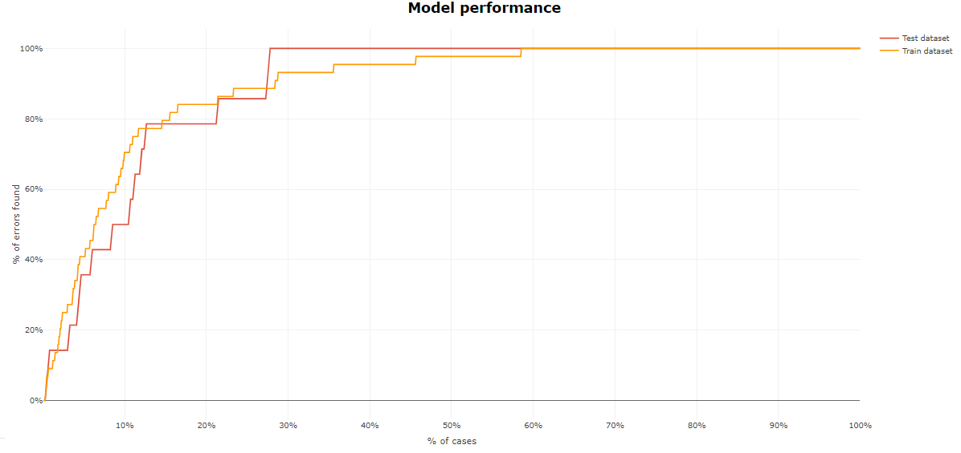
FATCA/CRS[8] - Neural Network
Full sample | Questions | Errors no | Errors ratio | Train sample | Test sample | Train sample error ratio | Test sample error ratio | 75% population cut off train | 75% population cut off test
1815 | 6 | 58 | 3,20% | 1452 | 363 | 3,03% | 3,86% | 100% | 100%
Selected population: 13% (47)
Errors detected: 79% (11)
Selected population: 15% (55)
Errors detected: 21% (3)
Selected population: 72% (261)
Errors detected: 0%(0)
Suggested cut off: 13%
Suggested cut off: 28%

Slide 23
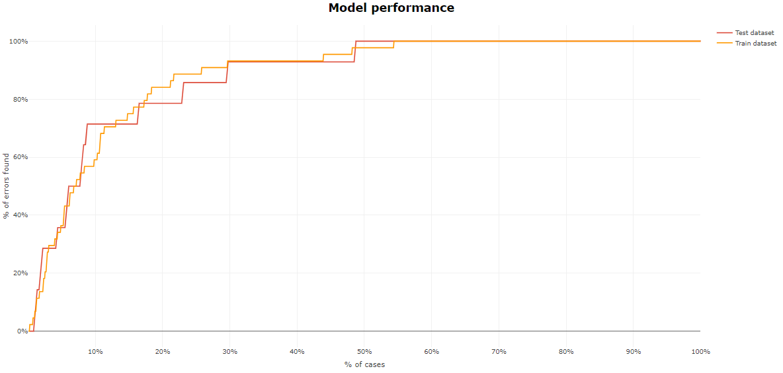
FATCA/CRS[8] - Lasso Logistic Regression
Full sample | Questions | Errors no | Errors ratio | Train sample | Test sample | Train sample error ratio | Test sample error ratio | 75% population cut off train | 75% population cut off test
1815 | 6 | 58 | 3,20% | 1452 | 363 | 3,03% | 3,86% | 100% | 100%
Selected population: 9% (33)
Errors detected: 71% (10)
Selected population: 40% (145)
Errors detected: 29% (4)
Selected population: 51% (185)
Errors detected: 0%(0)
Suggested cut off: 9%
Suggested cut off: 49%

Slide 24
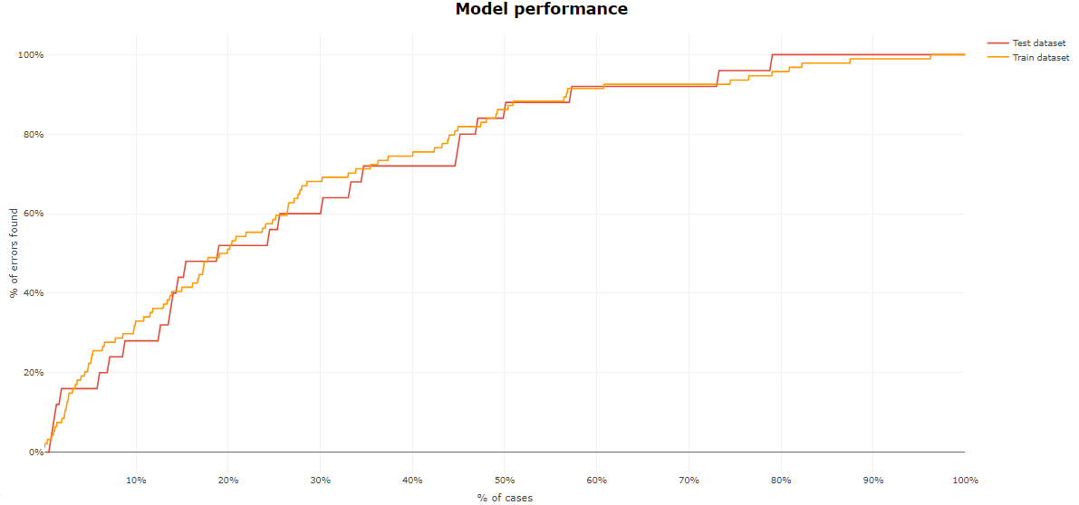
Control[9]
Full sample | Questions | Errors no | Errors ratio | Train sample | Test sample | Train sample error ratio | Test sample error ratio | 75% population cut off train | 75% population cut off test
1815 | 22 | 119 | 6,56% | 1452 | 363 | 6,47% | 6,89% | 93,62% | 96%
Selected population: 19% (69)
Errors detected: 52% (13)
Selected population: 38% (138)
Errors detected: 10% (6)
Selected population: 43% (156)
Errors detected: 8%(2)
Suggested cut off: 19%
Suggested cut off: 57%

Slide 25
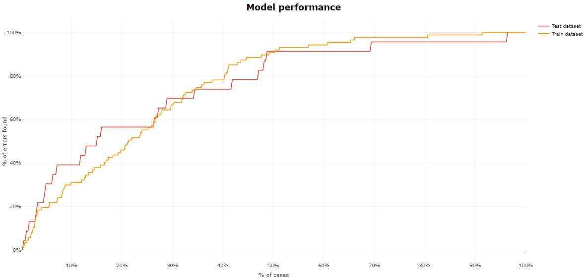
Critical[10]
Full sample | Errors no | Errors ratio | Train sample | Test sample | Train sample error ratio | Test sample error ratio | 75% population cut off train | 75% population cut off test
1815 | 110 | 6,06% | 1452 | 363 | 5,99% | 6,34% | 97,70% | 95,65%
Selected population: 29% (105)
Errors detected: 70% (16)
Selected population: 40% (145)
Errors detected: 26% (6)
Selected population: 31% (113)
Errors detected: 4% (1)
Suggested cut off: 29%
Suggested cut off: 69%

Slide 26
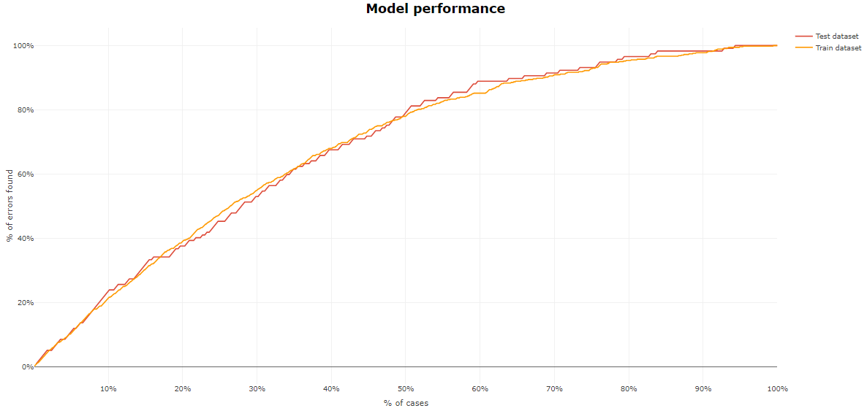
Major[11]
Full sample | Errors no | Errors ratio | Train sample | Test sample | Train sample error ratio | Test sample error ratio | 75% population cut off train | 75% population cut off test
1815 | 657 | 36,20% | 1480 | 339 | 36,49% | 34,93% | 92,78% | 93,16%
Selected population: 34% (114)
Errors detected: 60% (70)
Selected population: 39% (131)
Errors detected: 33% (39)
Selected population: 27% (90)
Errors detected: 7%(8)
Suggested cut off: 34%
Suggested cut off: 73%

Slide 27
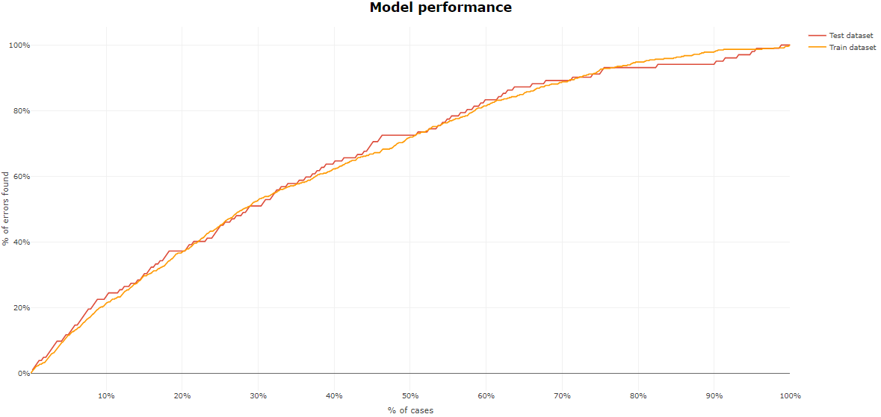
Minor[12]
Full sample | Errors no | Errors ratio | Train sample | Test sample | Train sample error ratio | Test sample error ratio | 75% population cut off train | 75% population cut off test
1815 | 566 | 31,18% | 1476 | 339 | 31,44% | 30,09% | 92,67% | 91,18%
Selected population: 29% (95)
Errors detected: 50% (51)
Selected population: 47% (159)
Errors detected: 43% (44)
Selected population: 24% (85)
Errors detected: 7%(7)
Suggested cut off: 29%
Suggested cut off: 76%

Slide 28
Thank you

